Slide 1

Introduction to Computer Systems
Processor Design
Direct Link to view these slides on Google Docs

Slide 2
What to expect in this topic:
Processor Design
Instruction Set Architecture
Instruction Formats
Operands: Location and number of operations
Addressing Modes
Instructions types
Fixed length vs Variable Length Instructions
CISC vs RISC computers

Slide 3
Processor Design & Instruction Set Architecture
Instruction set architecture
Decides instructions to provide
Decides forms of data access to provide
Processor design
Decides how to implement the desired instructions
Data paths and internal registers
*Pipelining and Parallelism come later

Slide 4
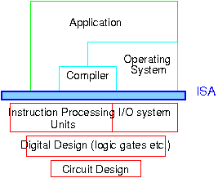
Instruction Set Architecture
The instruction set provides commands to the processor (~ Which is basically machine language), to tell it what it needs to do.
The instruction set consists of addressing modes, instructions, data types, registers, memory architecture, interrupt, and exception handling, and external I/O.
Instruction set architecture (ISA)
Design of operations used by processor
Number of registers
How data is accessed by Instructions
Processor microarchitecture
How instructions are implemented
How long they take to execute
How registers are organised

Slide 5
Instruction Set Architecture
With every tick of the clock, the CPU fetches and executes one instruction.
The clock speed is measured in cycles per second
E.g. 1 cycle / second is known as 1 Hz (Hertz).
Example:
CPU with a clock speed of 3 GHz (gigahertz) can carry out 3 thousand million (or 3 billion) cycles per second. Also,we use MIPS is a unit of computing speed equivalent to a million instructions per sec.
High level languages such as Java, Basic, etc. isolate programmer from instruction set
New processor may need to execute programs originally developed on earlier processors

Slide 6
Instruction Set Architecture
e.g. Y= (x + y) / x^2 – x^y
Operations
How many? 5 +, -, multiplication, division and exponential (x^2 and X^Y)
Which ones? Order of Operations >>
How complex?
Operands
How many? 1,2 or more operands ? 2 => X and Y
Location? Memory ? register ? Memory
Types? Real, floating, character, string ...etc. Real
Instruction format
Size – fixed or variable length
How many different formats?

Slide 7
Instruction Formats
Variable length instructions
more complex decoding
more flexibility
Fixed length
simpler decoding
may lead to larger programs
Examples:the following are 3 types of CPU
MIPS – fixed length 32 bits
Intel IA64 – variable from 1 to 17 bytes
VAX (1980s architecture) between 1 and 54 bytes!

Slide 8
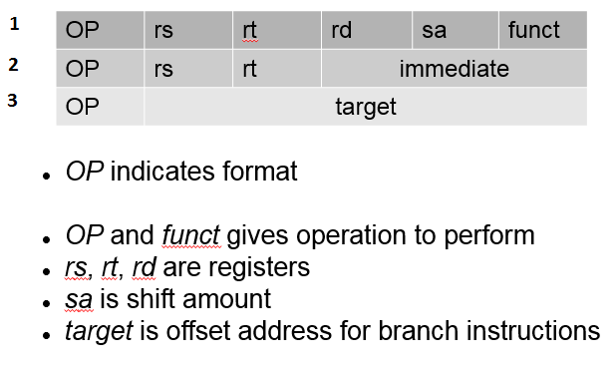
Instruction Formats
Multiple instruction lengths complicate decoding
Uses instruction bits to specify format
MIPS has only 3 formats

Slide 9
Instruction Formats
MIPS has only 3 formats
1 R-type format:
used when all the data values used by the instruction are located in registers.
opcode | rs | rt | rd | Shift amount | function
6bits | 5bits | 5bits | 5bits | 5bits | 6bits
src
src
dst
Used by add, sub etc.
add $t0,$t1,$t2 # $t0 = $t1 + $t2; add as signed
integers

Slide 10
Instruction Formats
MIPS has only 3 formats
2 I-type format:
Instructions are converted into machine code words in the following format:
opcode | rs | rt | address
6 | 5 | 5 | 16
src
dst
offset
Used by lw (load word), sw (store word) etc.
lw $t2, ($t0) # load word at RAM address contained in $t0 into
$t2
sw $t2, ($t0) # store word in register $t2 into RAM at address
contained in $t0

Slide 11
Instruction Formats
MIPS has only 3 formats
3 J-type format:
J 10000 is represented as
Opcode | target
2 | 10000
6-bits
26 bits
Jump instructions: unconditional transfer of control
Example:
j target # jump go to the specified target address (subroutine)
jr rs # jump register go to the address stored in rs
# (called an indirect jump)
Note: I-type format used for conditional branches
A Minimalistic Introduction to MIPS Instruction

Slide 12
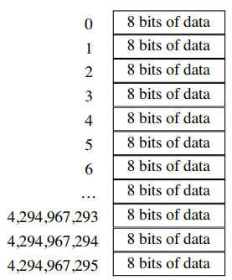
Operands: Location
Operands usually in either
Registers (MIPS – 32 integer registers, 32
Floating point registers)
MIPS addresses 4 Gigabytes of memory:
Registers
Easy to specify (5 bits for 32 registers)
Fast access (close to processor)
Load-Store architecture
Arithmetic and logical operations operate on registers
Memory only accessed to load value into a register or
store value from a register

Slide 13
Operands: How Many?
Many operations imply 3 operands
x = y + z
Instruction set architectures exist specifying between 0-3 operands.
0 no explicit operands (e.g. stack architecture ) and
3 operands (explicitly),
– Memory-Memory
– Register-Memory
– Register-Register
Operands may also be implicitly specified
Example: x = y + 5
y << y + 5 # add 5 to y contents and store in y
X << y # store y contents (y + 5) into x

Slide 14
Operands: How Many?
Stack:
Most operands implicit
x = y + z
Operations to load data on to stack and store data from stack
Arithmetic operations implicitly use top locations of stack
LD y
LD z
ADD
ST x
Cycle 1 → | Cycle 2 → | Cycle 3 → | Cycle 4 → | Cycle 5
 |  | z
 | y | y | x
… | … |  |  | …

Slide 15
Operands: How Many?:
Accumulator:
1 explicit address
Example: ADD # adds to the accumulator
x = y + z
LD y # y loaded into AC
ADD z # adds z contents to the accumulator (y)
ST x # store AC into x location

Slide 16
Operands: How Many?:
General Purpose Register:
2 or 3 explicit addresses
Destination of results usually a register
Other operands may be registers or memory locations
x = y + z
LD R1,y # Load contents of y into R1(register)
ADD R1,z # implicitly add contents of z to R1
ST R1,x # store contents of R1 into x (register/memory), explicit

Slide 17
Operands: How Many?:
Load/Store Architecture:
Operations take place between registers
Only access to memory is explicit load or store instructions
x = y + z
LD R1,y
LD R2,z
ADD R3,R1,R2 # R3= R1+R2
ST R3, x

Slide 18
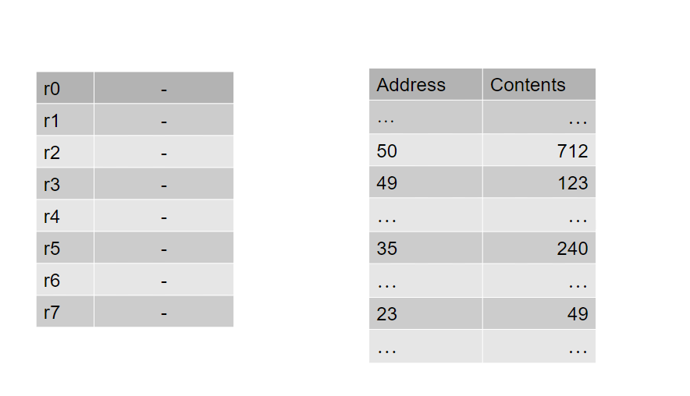
Addressing Modes
Different ways an instruction can specify memory address of data to load (not MIPS - generic)
*Here we have a representation of the registers of an imaginary machine and a few of its memory locations. For simplicity, everything is given in decimal notation here.
Machine with 8 general purpose registers:

Slide 19
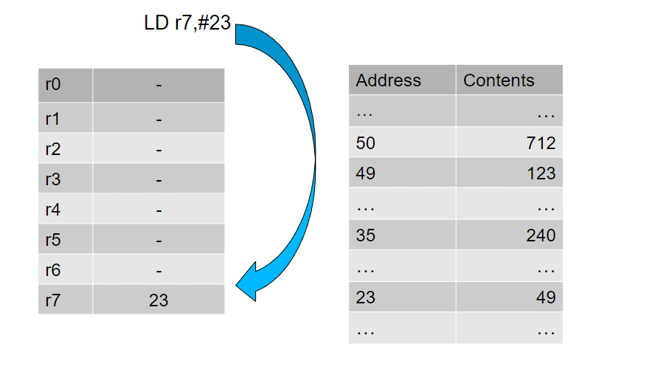
Addressing Modes: Immediate Addressing
operand specified directly in instruction - no need for a second access to memory

Slide 20
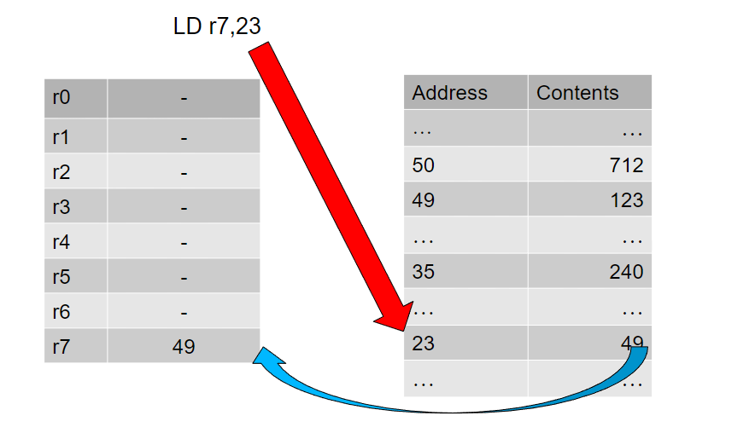
Addressing Modes: Direct Addressing
Address specified in instruction red arrow shows address being used to fetch the data, and the blue arrow shows the data transferring to the register

Slide 21
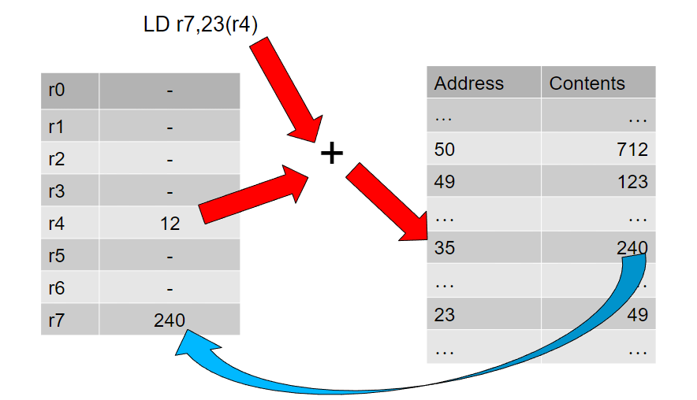
Addressing Modes: Indexed Addressing
In indexed operation contents of a register are added to the address given in the instruction to give effective address

Slide 22
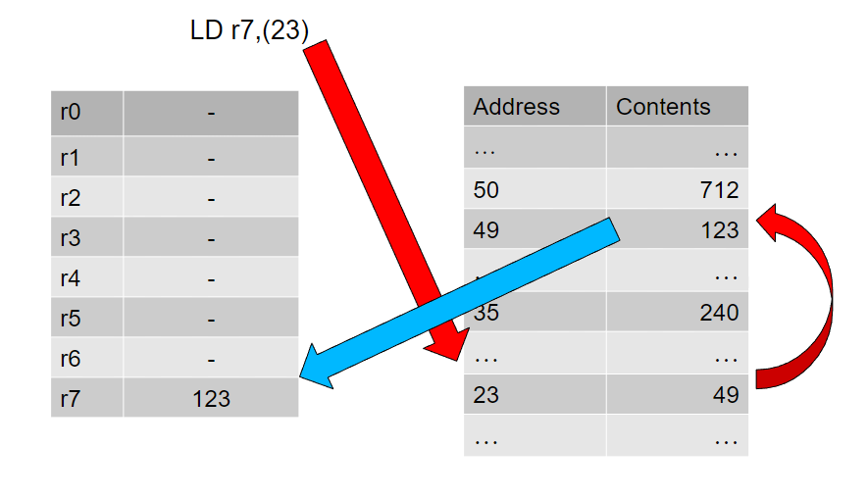
Addressing Modes: Indirect Addressing
Instruction gives address where address of operand is stored

Slide 23
Addressing Modes: MIPS
MIPS only provides
immediate
direct
indirect (using a register rather than memory)
indexed

Slide 24
Instructions
Arithmetic
add, subtract, multiply, divide
Logical
and, or, xor, shift-left, shift-right
data transfer
load word, store word, load byte, store byte
Branching
jump, conditional jump, jump and link (call and return)
special purpose
system call
no operation
A Minimalistic Introduction to MIPS Instruction

Slide 25
Fixed Length vs Variable Length Instructions
Fixed length instructions easier to decode
Location of next instruction obvious (for updating PC)
Variable length instructions may give shorter programs
if common instructions are encoded in short forms

Slide 26
Complex Instruction Set Computers (CISC)
The primary goal of CISC architecture is to complete a task in as few lines of assembly as possible, more H/W devices (Higher cycles per instruction) Emphasis on hardware.
From 1950s to 1970s architectures became more complex
More addressing modes
Instructions with complex effects and side effects
IBM 360
VAX
Ia64
CISC has the ability to execute addressing modes or multi-step operations within one instruction set (Emphasis on hardware)
Sophisticated operations are not cost free (Higher cycles per instruction)
Difficult for compilers to make use of them

Slide 27
Complex Instruction Set Computers (CISC)
Example:
MULT 2, 5
When executed, this instruction loads the two values into separate registers, multiplies the operands in the execution unit, and then stores the product in the appropriate register.
Thus, the entire task of multiplying two numbers can be Completed with one instruction.

Slide 28
Reduced Instruction Set Computers (RISC)
The primary goal of RISC architecture is to use simple instructions that can be executed within one clock cycle.
In early 1980s movement to have very simple instruction sets
Reduce number of addressing modes
Instruction sets designed for compilers to use
MIPS is the archetypal RISC machine
Simpler instructions with fewer options means hardware
can be minimised
Intel Pentium & IA64 are RISC machines

Slide 29
Reduced Instruction Set Computers (RISC)
Example:
The "MULT" command described in CISC could be divided into three separate commands:
"LOAD," which moves data from the memory bank to a register, "PROD," which finds the product of two operands located within the registers, and "STORE," which moves data from a register to the memory banks.
Code of four lines of assembly in RICS instead of one line in CISC:
LD R1,2 #LOAD A, 2
LD R2,5 #LOAD B, 5
Mul R3,R2,R1 #PROD A, B
ST R3 #STORE A

Slide 30
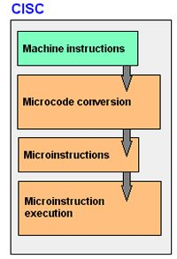
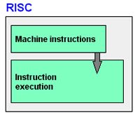
CISC v RISC
CISC | RISC
Emphasis on hardware | Emphasis on software
Includes multi-clock | Single-clock
Complex instructions | Simple (reduced) instructions
Small code sizes, | Large code sizes
High cycles per second | Low cycles per second

